Slide 1
STM(Smart TDS Meter)
Prepared by:
Vignesh patel (14ce110)
Urvish rana (14CE117)
Kushal Reshamdalal (14ce120)

Slide 2
Introduction
Project description
Problem addresses
Objective
Scope
System architecture
System requirements
Developer’s/User’s requirement
Future enhancement

Slide 3
Description
Purifier used in any water plant or Reverse Osmosis system needs to be serviced in manual period of time, depending on usage and quantity of water to be purified.
Smart Purifier system will help by checking automatically the quality of water and will inform the user to service the purifier system.

Slide 4
Problem addresses
The TDS value of water increases according to the usage of the membrane in the purifier(Values ranging from 50-200 is good for health).
We need to call company vendors manually to check the purifier system.

Slide 5
Objectives
Applicable in any remote water plant(Purifier).
No need to check TDS value of water manually.
Customize TDS value according to the hardness of water.
Easy to use the user interface of an android application.

Slide 6
Scope
12hr scheduled calculation and upload is held.
Manual refreshment to get present TDS value.
Can have access over any region on the earth.(Needed internet connection).
High speed data transmission over MQTT protocol.

Slide 7
System Architecture
Using NodeMCU development board to enhance the connectivity with the local Wi-Fi network.
Interfacing the conductivity sensor onto the NodeMCU board which will return the conductivity of the water (Solution).
TDS Value can be derived from conductivity of water.
Uploading the data(TDS) to the cloud.
MQTT protocol to transmit the data in very short time (milliseconds).
Using android device to fetch the data from multiple source as well as interface with it.

Slide 8
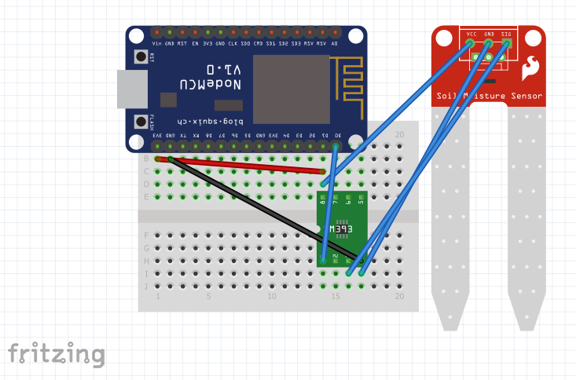

Slide 9
Developer’s requirement
Software requirement
Android studio 2.0
Android SDK.
Hardware requirement
NodeMCU Development Board.
Water Conductivity Sensor.

Slide 10
User requirements
Android device with Android version 4.0 and above.
512 MB of RAM.
Active internet connection.

Slide 11
Future enhancements
More water quality solutions like,
Present water minerals.
Calculate the acidity (pH) of water resource(Lake,river) to detect chemical linkage from the industries.
Can be interfaced into any organization’s analytical machine to have an eyes over.
Stream the data directly to purifier vendors to get interface with system.

Slide 12
THANK YOU

